Slide 1


How-to:
Join the online conference in ZOOM

Slide 2
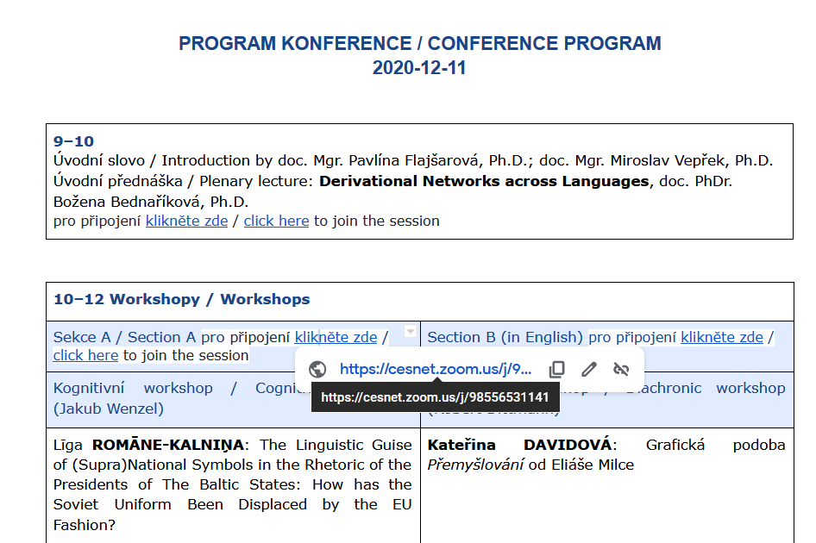
In the conference program, click on the session you wish to join.

Slide 3
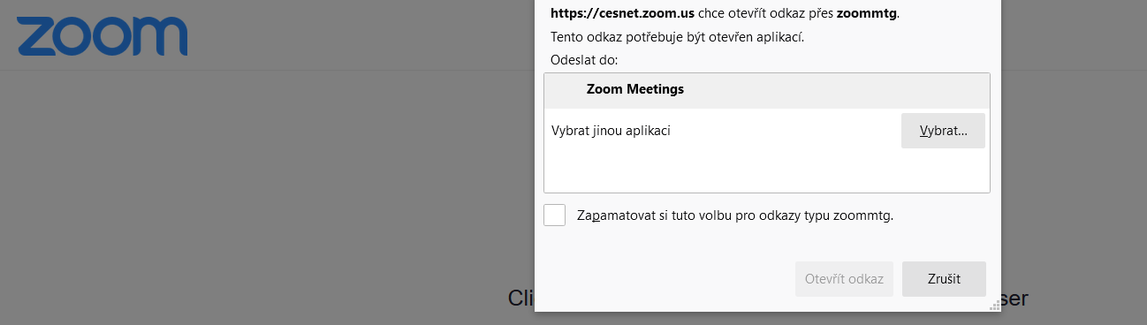
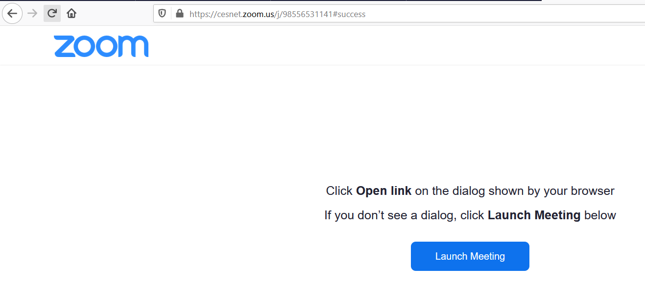
If you have ZOOM installed in your computer, click on Launch Meeting to start the application.

Slide 4
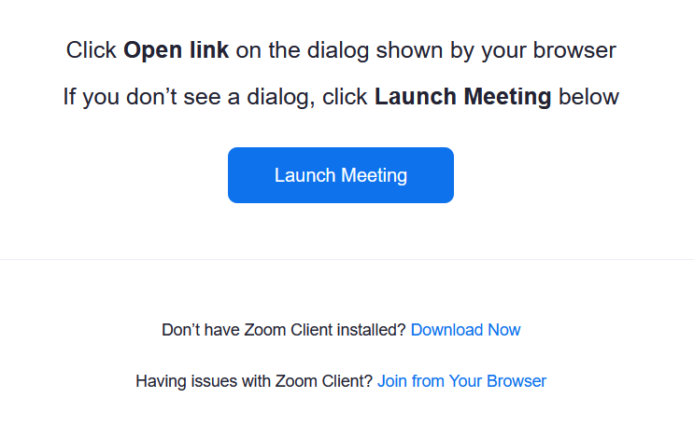
If you wish to launch the meeting in the browser (Explorer, Chrome, etc.), choose Join from Your Browser.

Slide 5
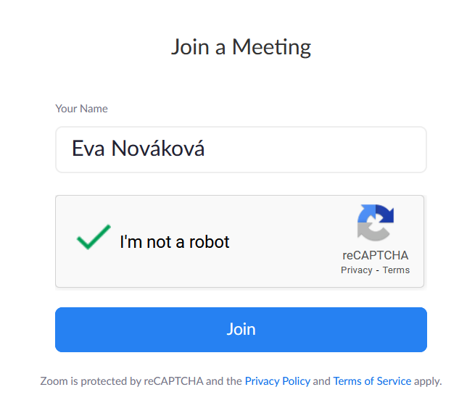
Enter your name, confirm you are not “a robot”, and click on the Join button.

Slide 6
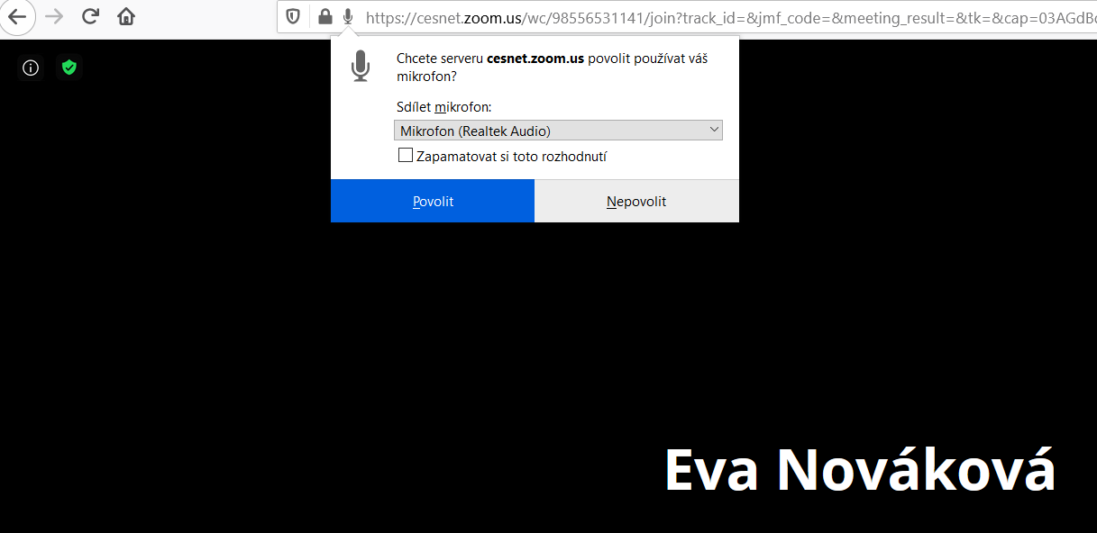
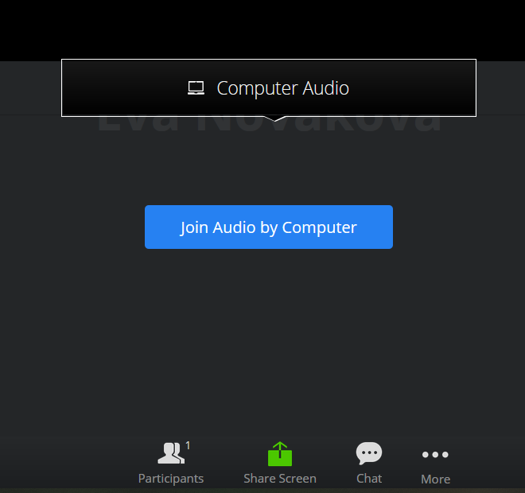
Allow the access to your computer speakers and microphone.
Some browsers may ask you to confirm that ZOOM can use your speakers and mike in a pop-up window.

Slide 7
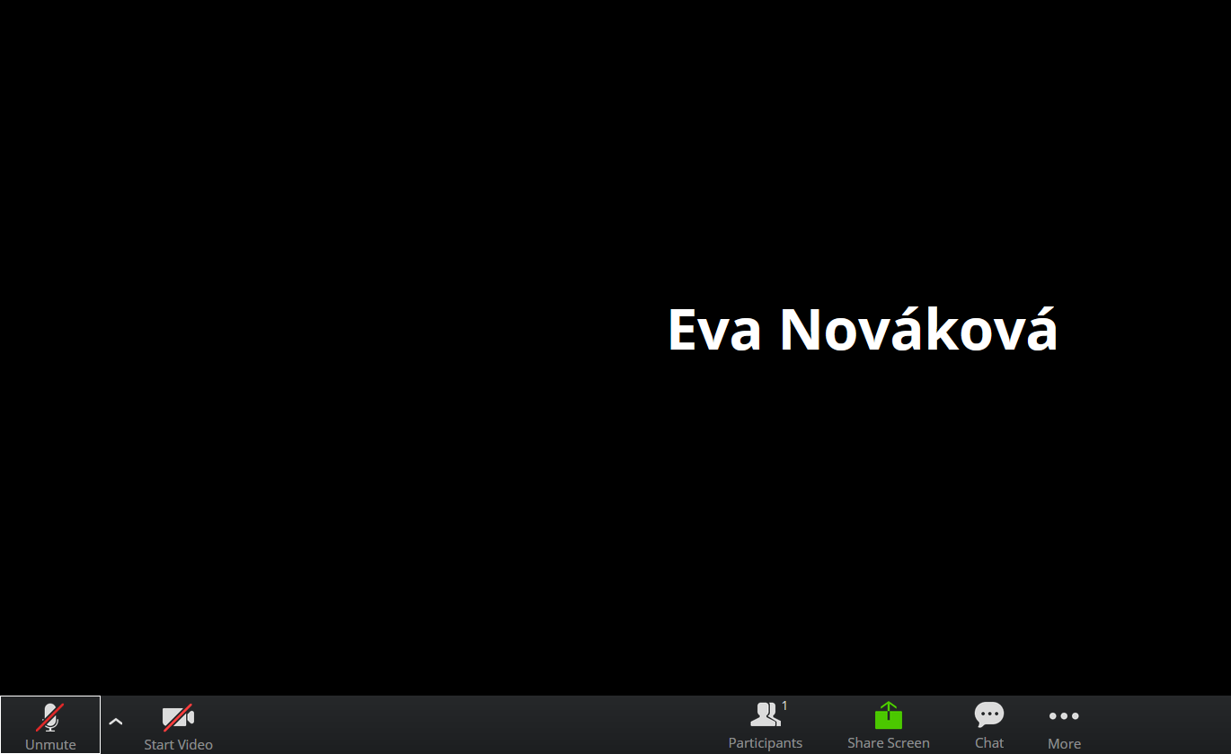
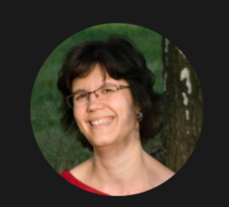
At the meeting:
Make sure your speakers are on but, please, switch off your microphone. This helps to keep the background noise to a minimum.
Feel free to switch your camera on–speaking to faces rather than name tags is much nicer for presenters. (Your camera and speakers can be switched off and on again any time during the meeting.)

Slide 8
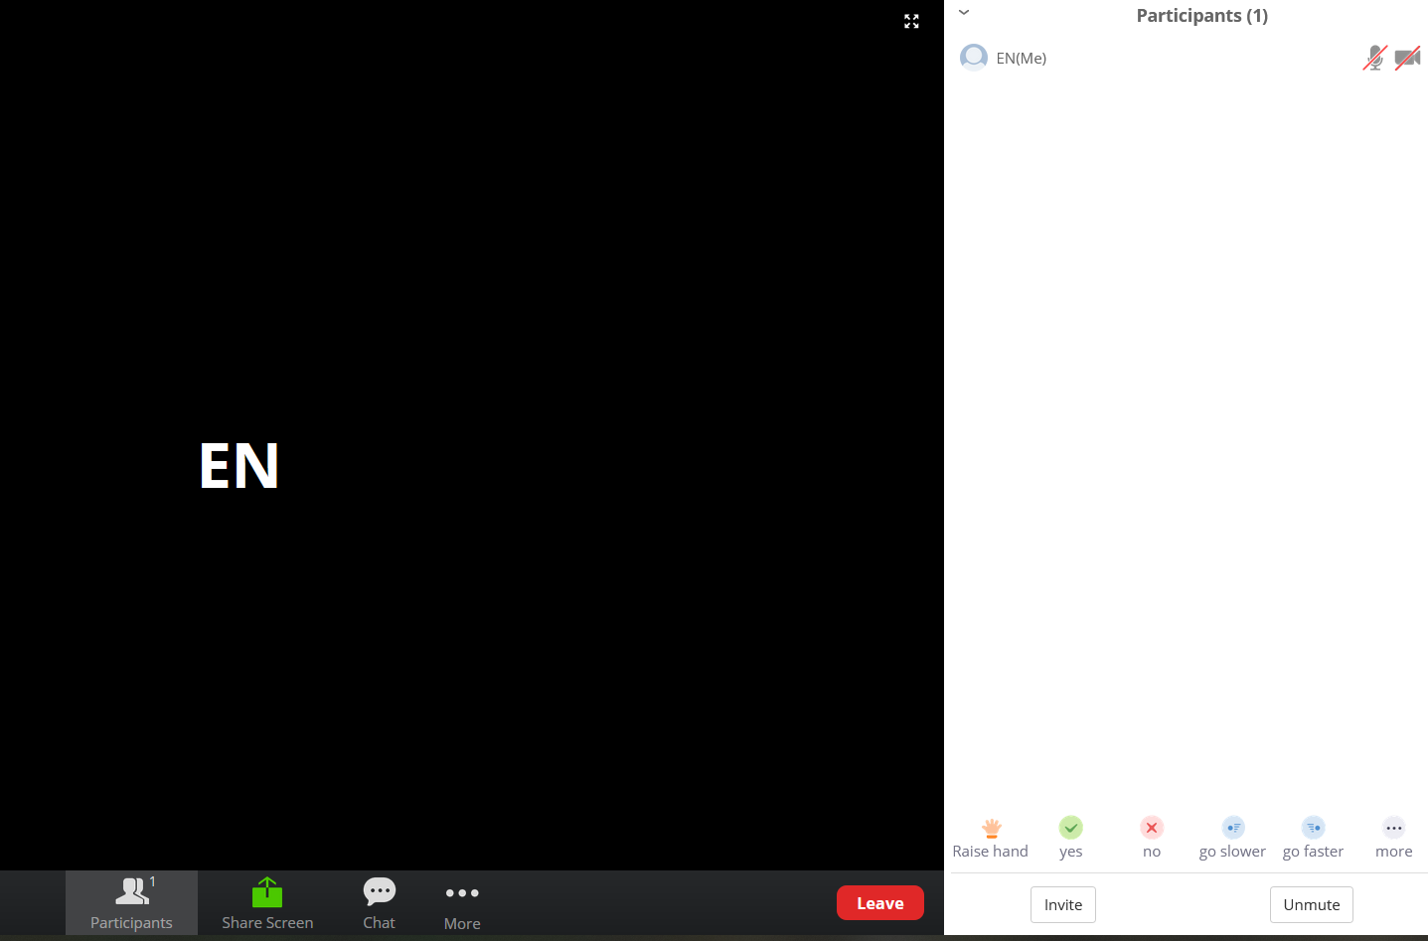
If you have a question, click on Participants and use the button Raise your hand. Please wait before the Chair gives you the floor.

Slide 9
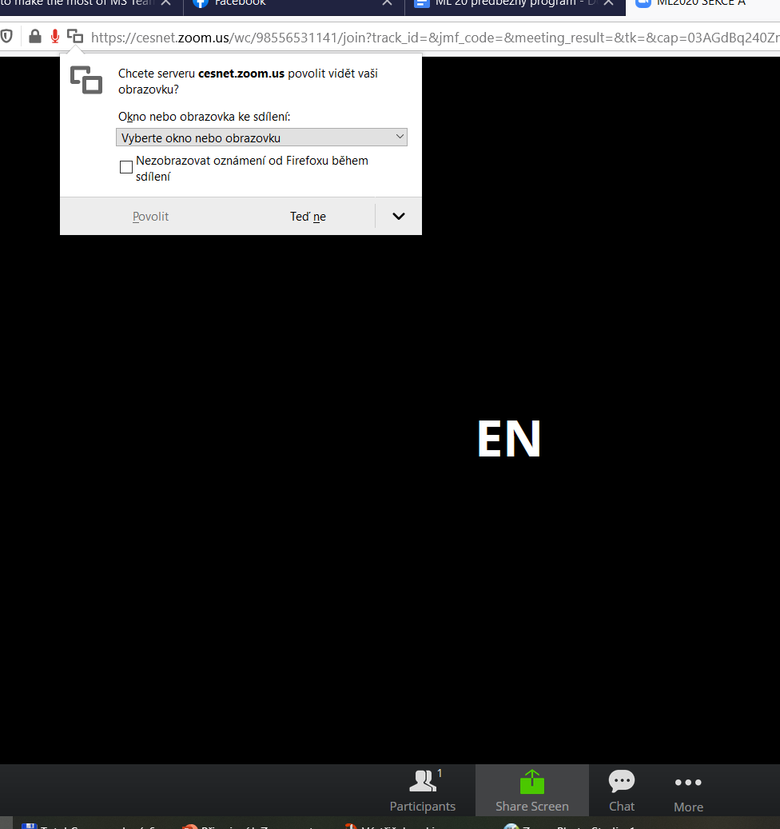
Presenting in ZOOM:
Make sure that your microphone (and your camera) is switched on.
Click on Share Screen and choose what you want to share. You can show either the desktop, or a selected application (Power Point, etc.).

Slide 10
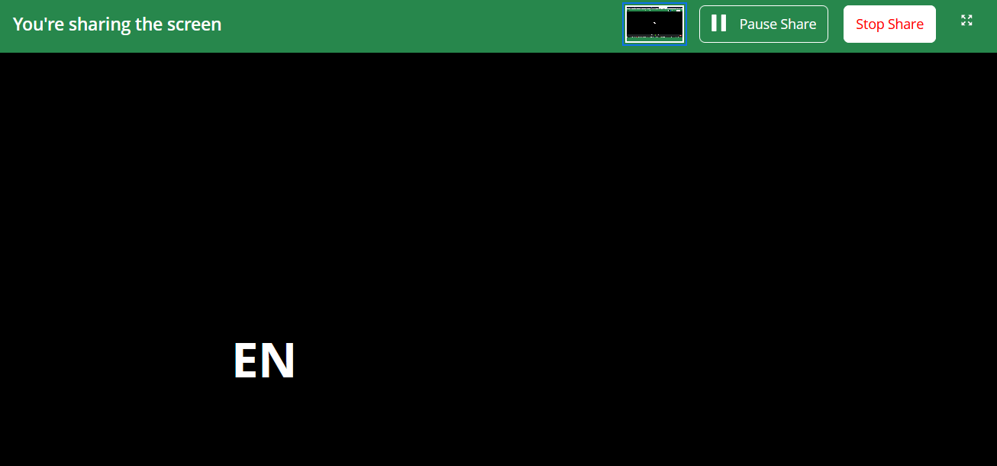
Sharing can be paused or finished by clicking on Pause/Stop buttons.

